Slide 1

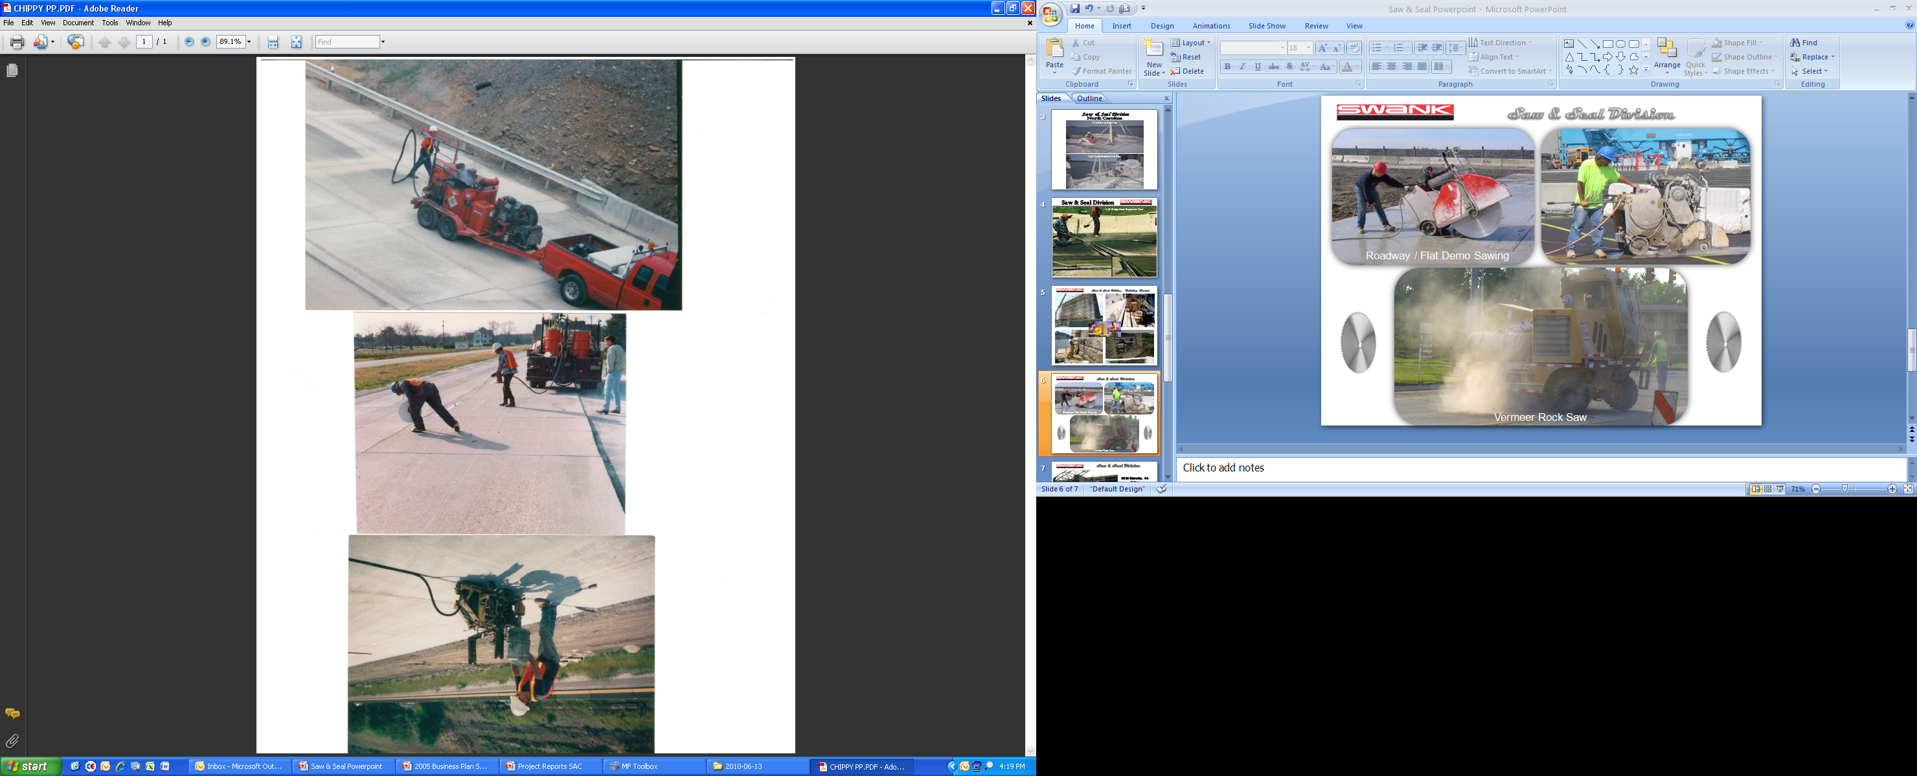
Saw & Seal Division
Roadway Sealing Operations
Neoprene Compression Seal
Hot Pour Joint Sealing
888 Silicone Joint Sealing

Slide 2
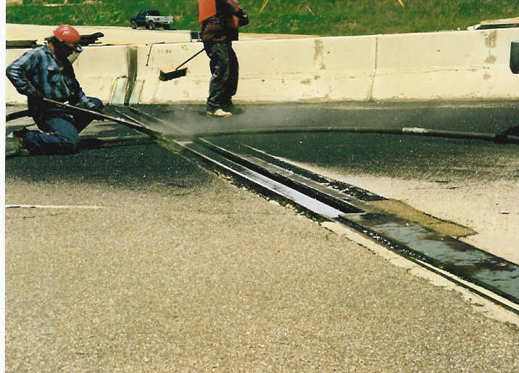
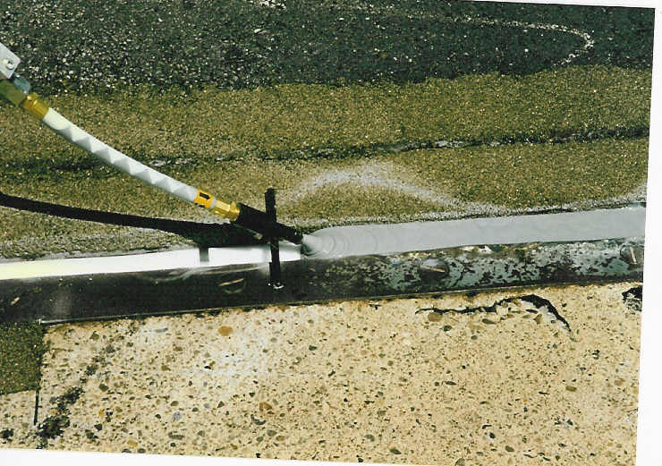
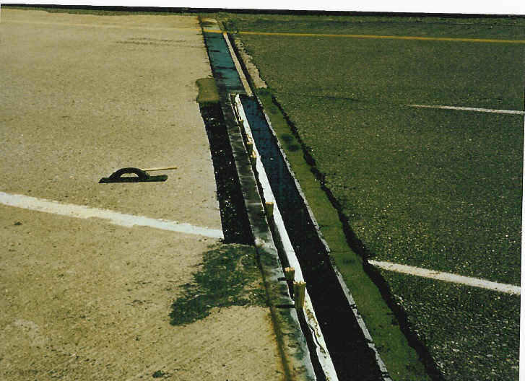
Saw & Seal Division
XJS Bridge Deck Expansion Dam

Slide 3
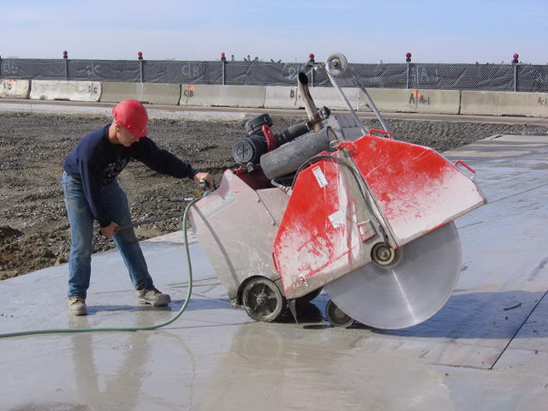
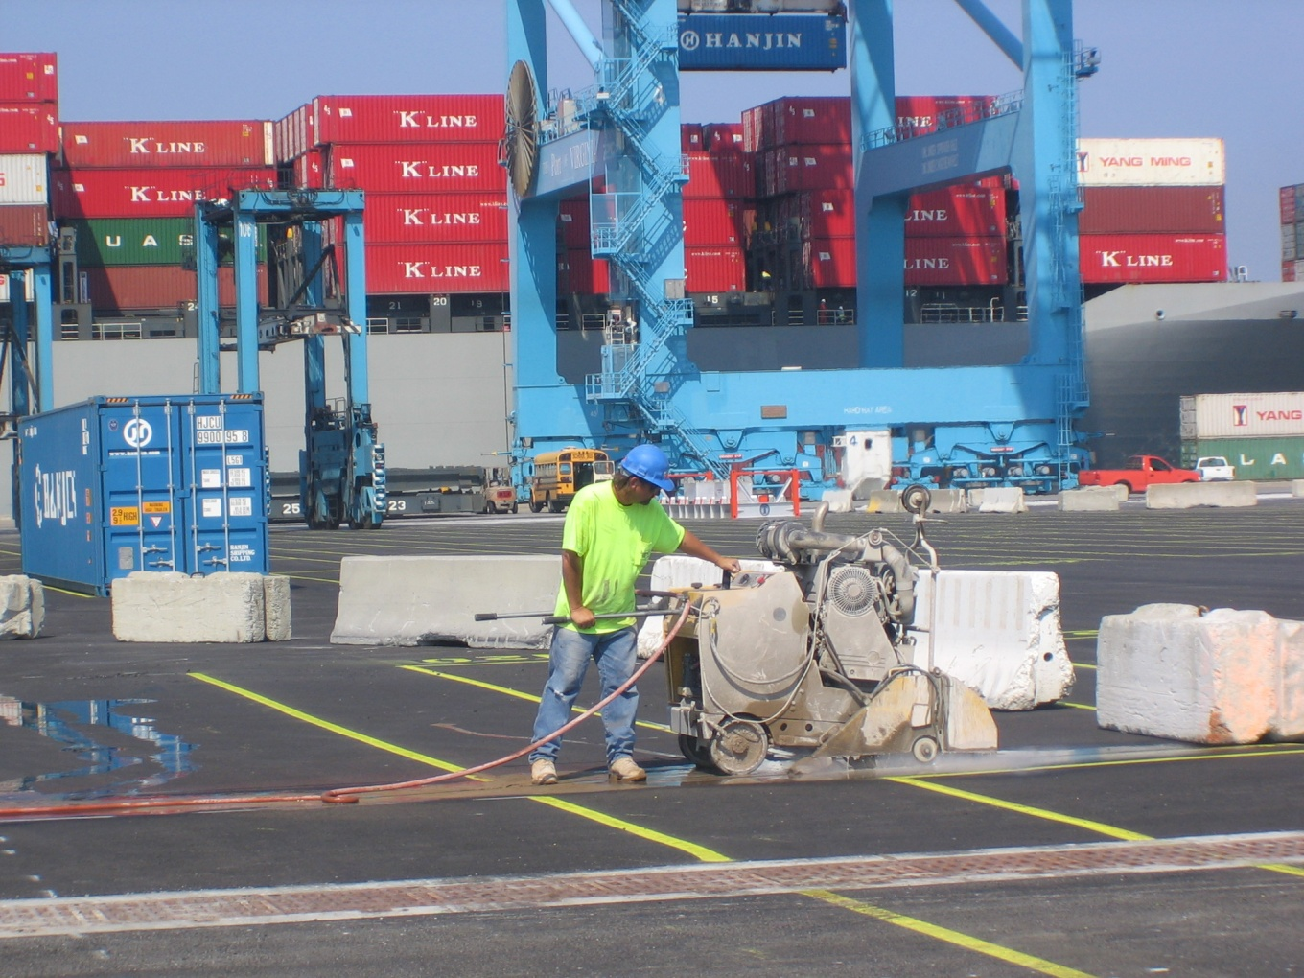
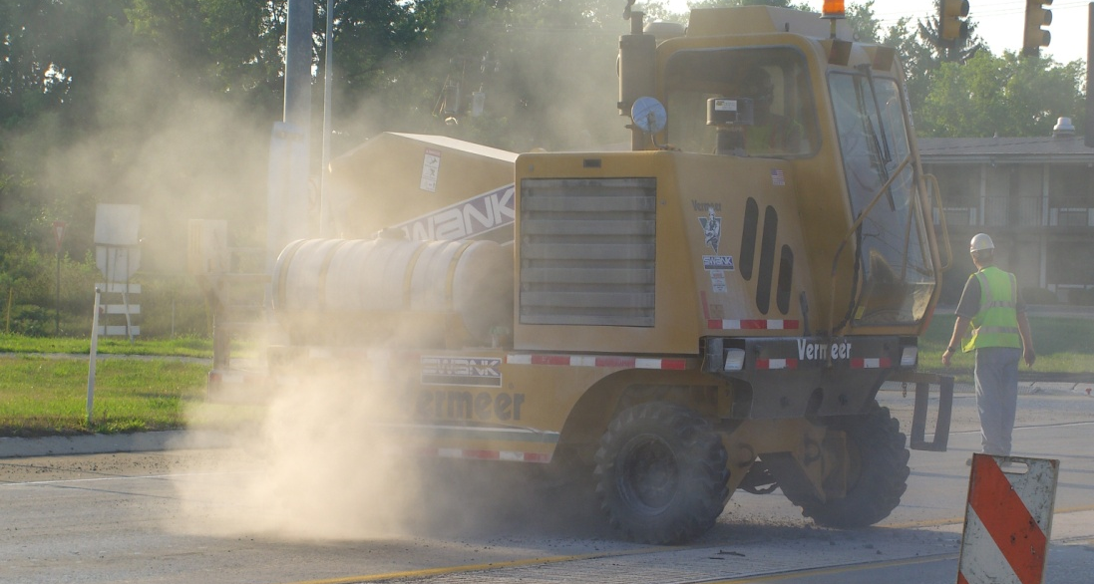
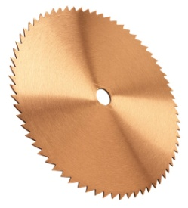
Saw & Seal Division
Roadway / Flat Demo Sawing
Vermeer Rock Saw

Slide 4
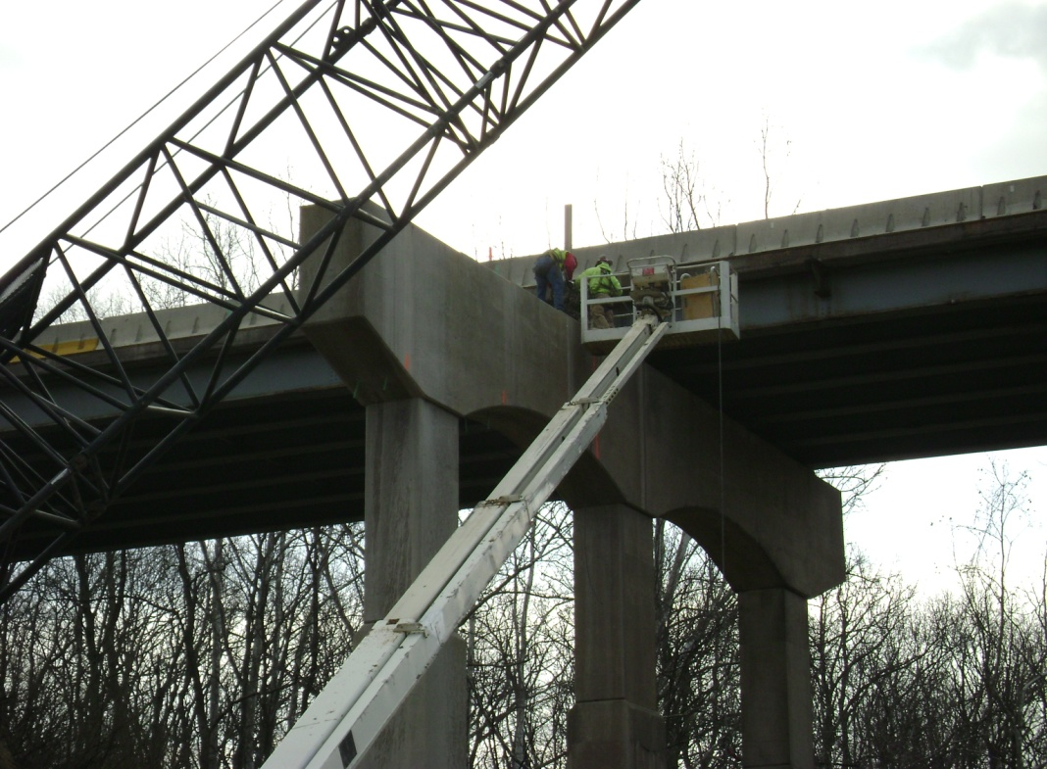
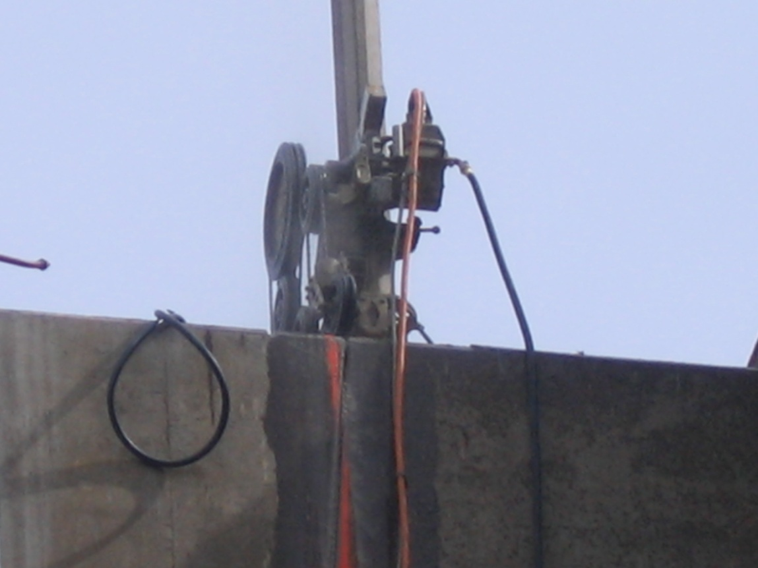
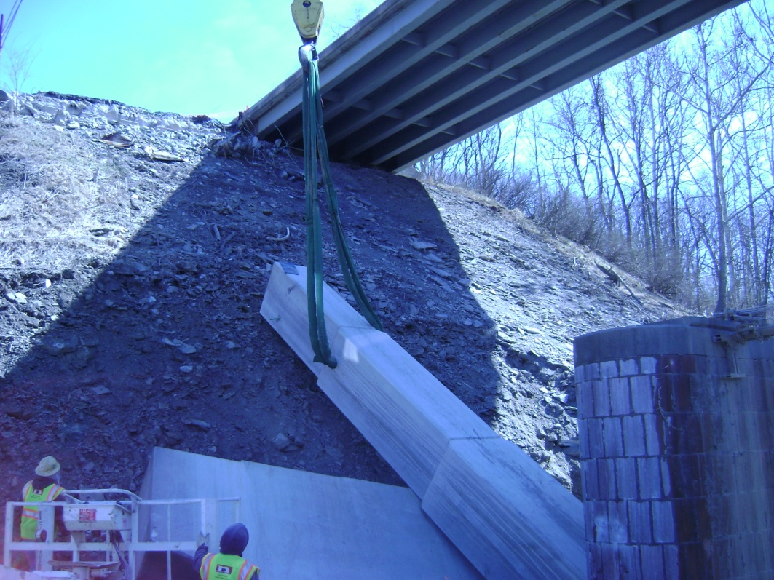
Saw & Seal Division
SR 22 Blairsville, PA
Prime:
New Enterprise S&L
Wire Sawing Bridge Pier

Slide 5

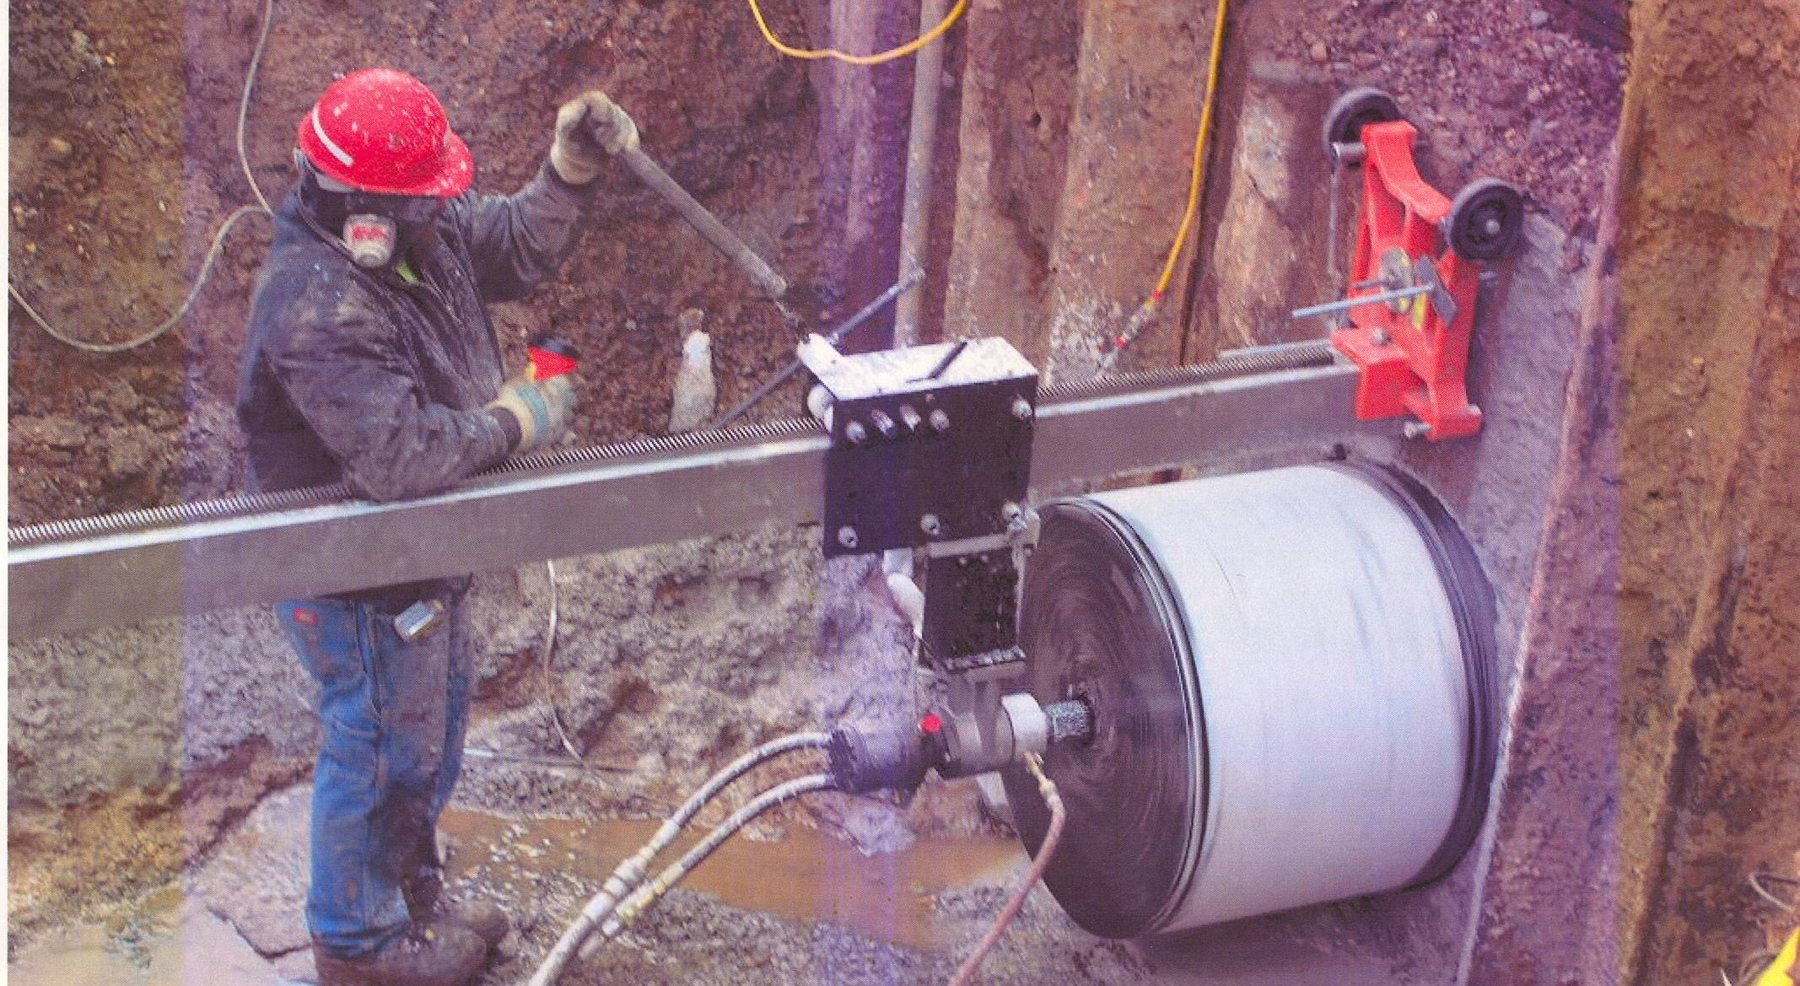
Saw & Seal Division
Pennsylvania
Drilling through foundation at Brunner Island Power
Plant using a Hydraulic Core Drill
32" Diameter Hole, 6' In Depth

Slide 6
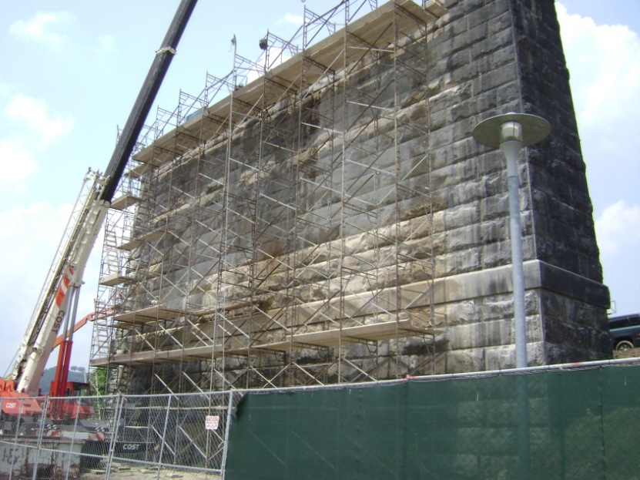
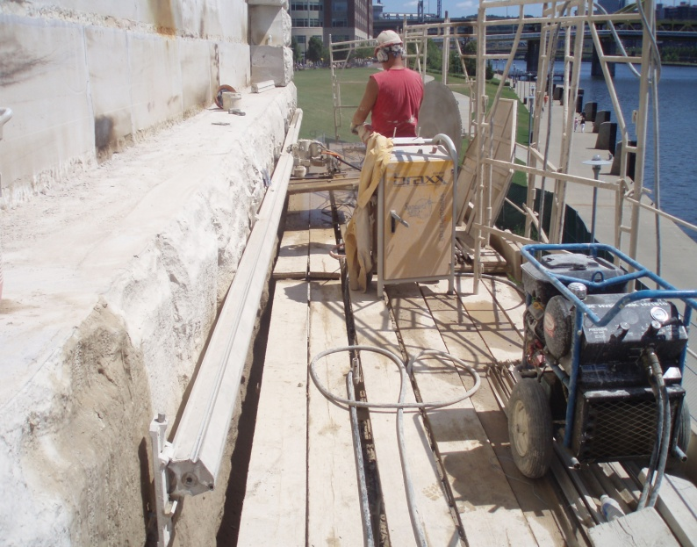
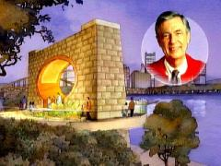
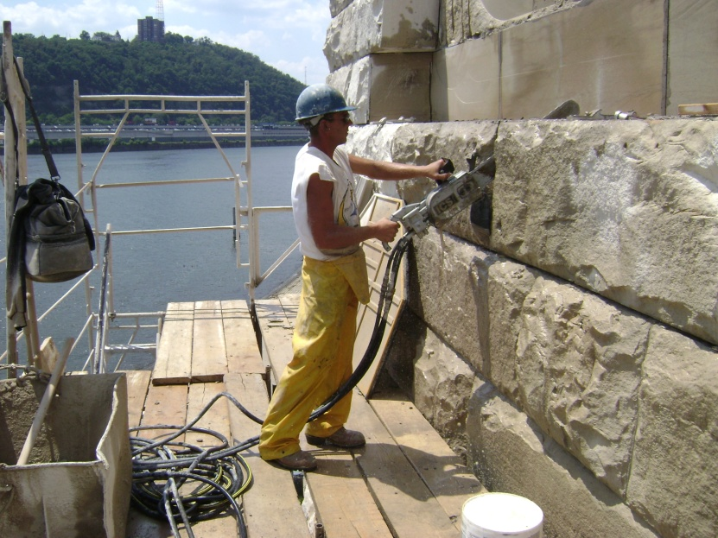
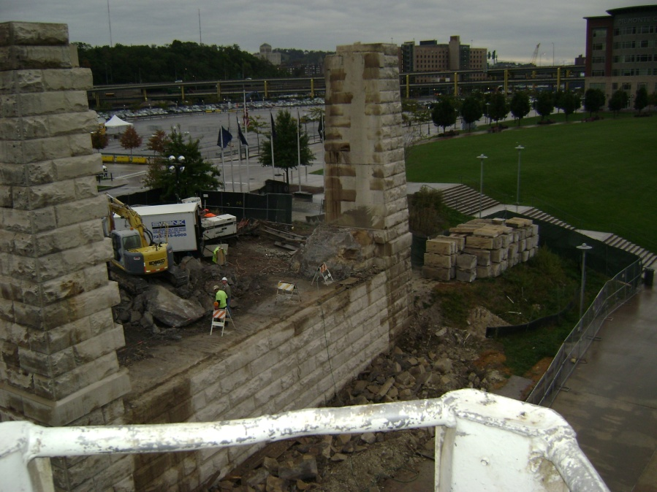
Saw & Seal Division, Building Trades

Slide 7
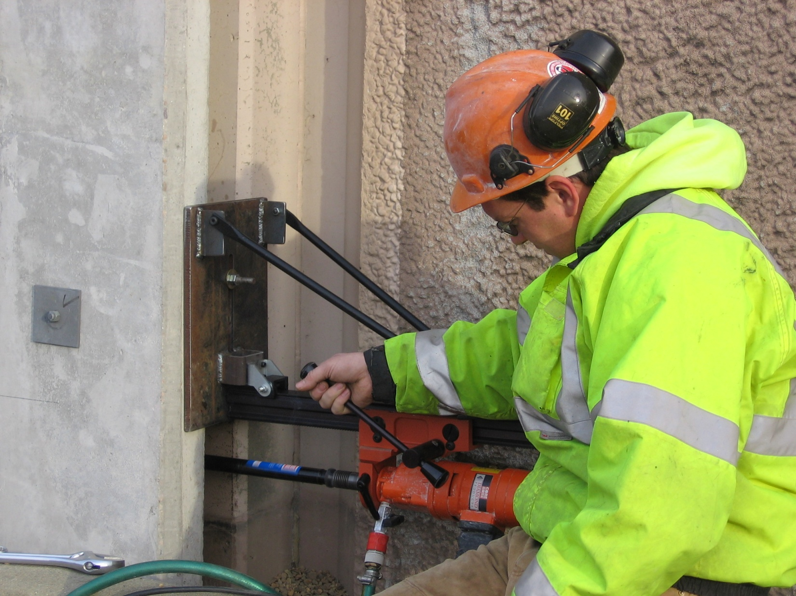
Saw & Seal Division
Virginia Beach Division
Small Diameter Core Drilling on a Sound Wall

Slide 8
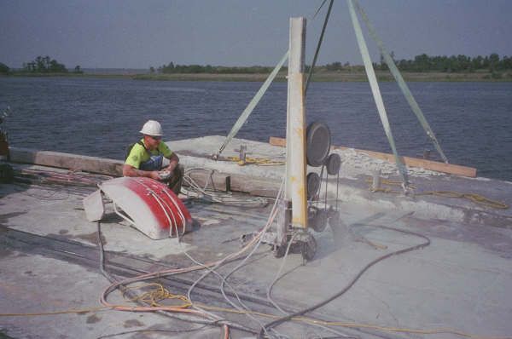
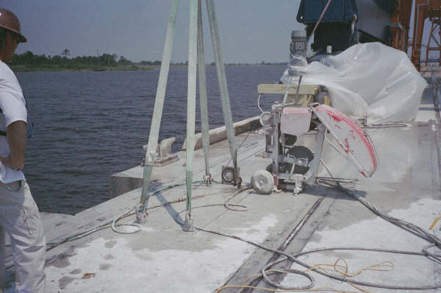
Saw & Seal Division
North Carolina
Wire Sawing Sea Wall
High Cycle Electric Wire Saw

